Slide 1
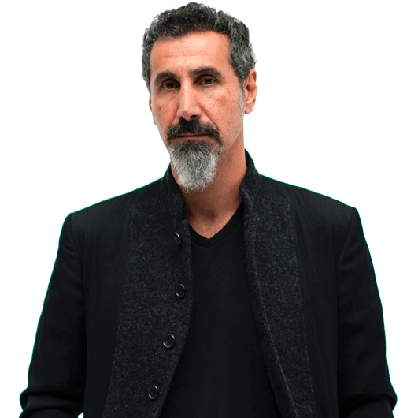
Serj Tankian is one of my favorite idols.
He is musician, singer, composer, music producer, painter, poet and activist.
He is from Beirut, Lebanon.
He has Armenian, Lebanese, United States and New Zealand nationality.
He is 53 years old.
He is tall.
He is slim.
His skin is fair.
His hair is short, curly and black with white.
His beard is medium and white.
His nose is normal.
His eyebrows are small.
His eyes are small and dark.
His ears are big.
He have a Grammy Award.
His voice is spectacular.

Slide 2
He was a singer.
He was American.
He was one of the best singers of his time.
He had curly and black hair.
His skin was black, but it changed to fair.
His dance steps are history.

